Slide 1
Credit Card Fraud Detection
Elton Tetteh Okley
December 6th, 2022

Slide 2
Outline
Introduction
Data
Methodology
Results

Slide 3

Introduction
$34.4bn
$28.6bn
2019
2021
2020
2022
$28.7bn
$32.2bn
Source: https://wallethub.com/edu/cc/credit-debit-card-fraud-statistics/25725

Slide 4

Data
Data was obtained from kaggle.com
Contains transactions made by European credit cards on Sept’13
Features transformed by PCA except amount of transaction
Dependent variable flags fraud transactions

Slide 5
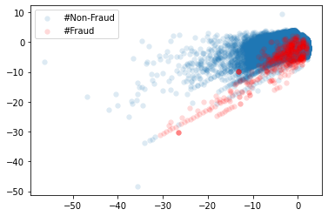
Data
Contains 284,806 observations
31 Variables
Highly unbalanced
%Fraud: 99.8%
%Non-fraud: 0.2%

Slide 6
Methodology
Split data into 70% training and 30% out of sample
Proceed with Model that gives best CV score & build Neural Net Classifier
Compare final models
01
02
03
04
05
Perform 5-fold CV with Logistic Regression & Random Forest Classifier
Evaluate the built models using relevant metrics

Slide 7
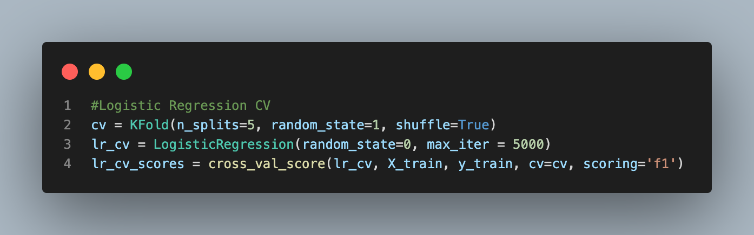
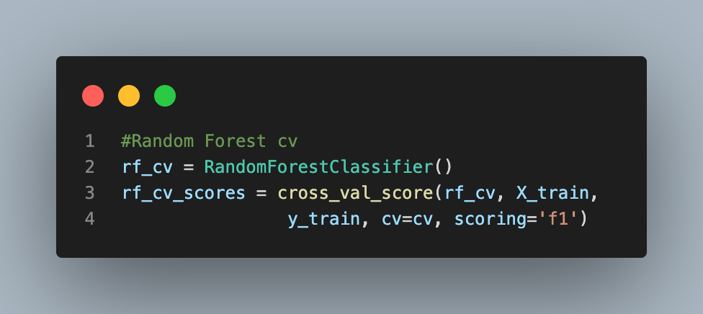
Results
Logistic Regression Avg. F1 Score: 72%
Random Forest Classifier Avg. F1 Score: 85%

Slide 8
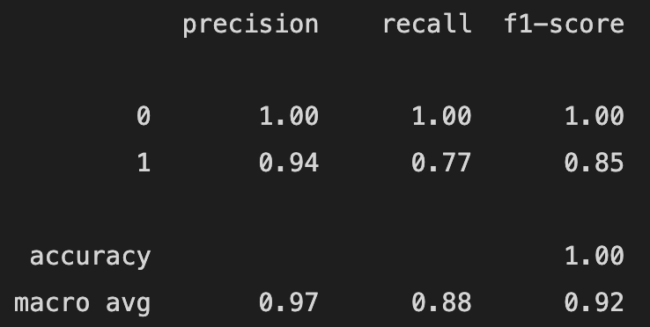
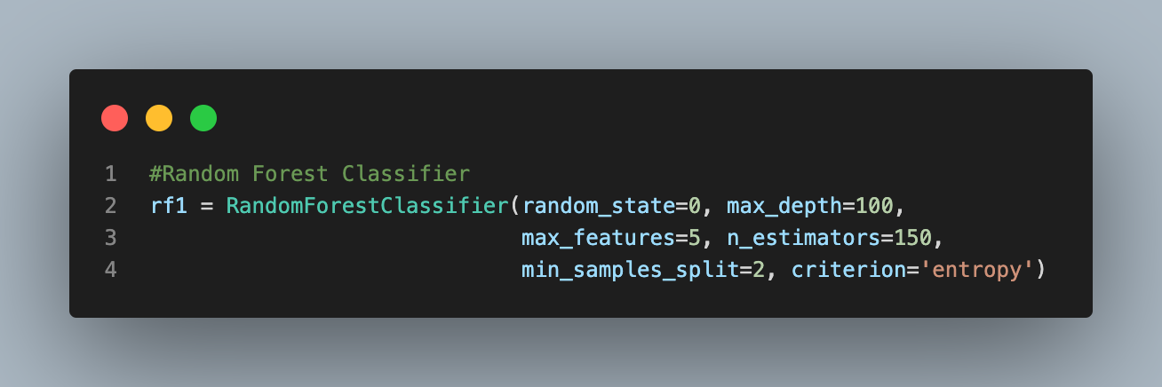
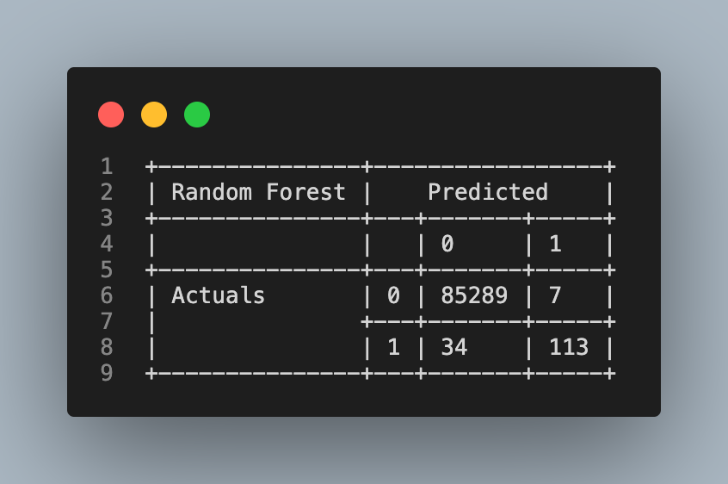
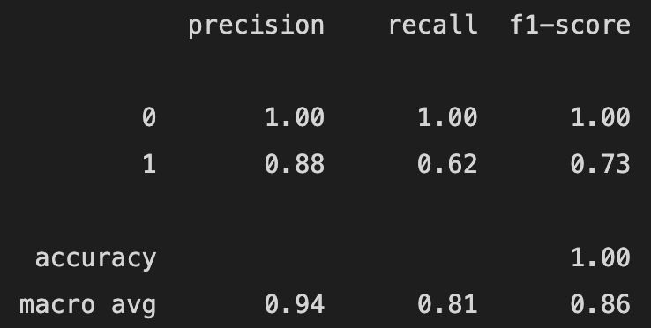
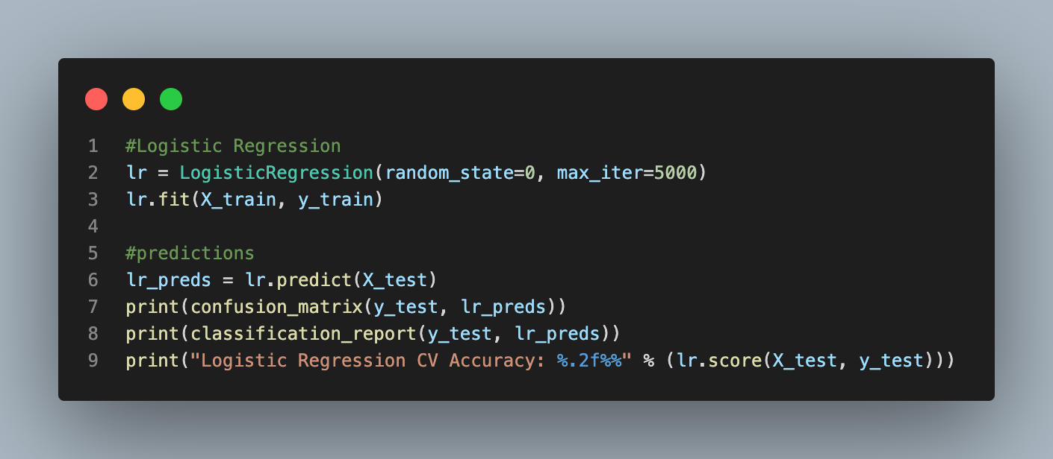
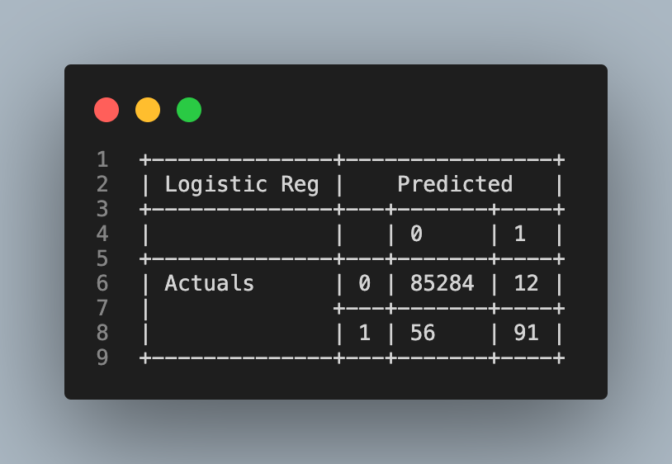
Results
Confusion Matrix
Random Forest
Classification Report
Logistic Regression

Slide 9
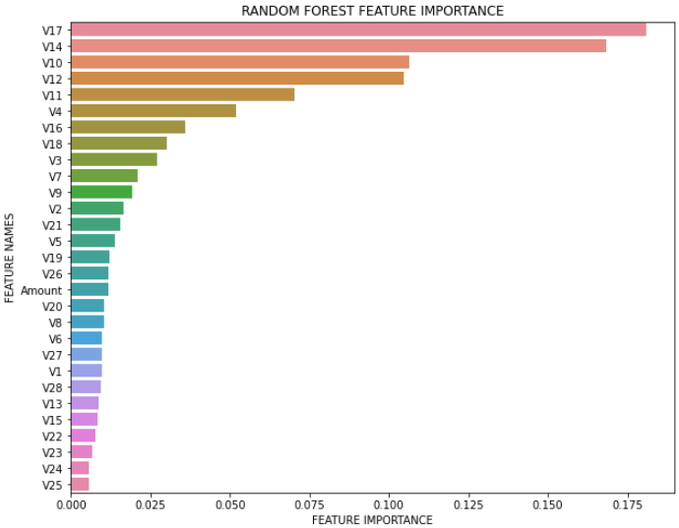
Random Forest – Variable Importance
V17, V14, V10, V12, V11 & V4 are most important in detecting credit fraud.

Slide 10
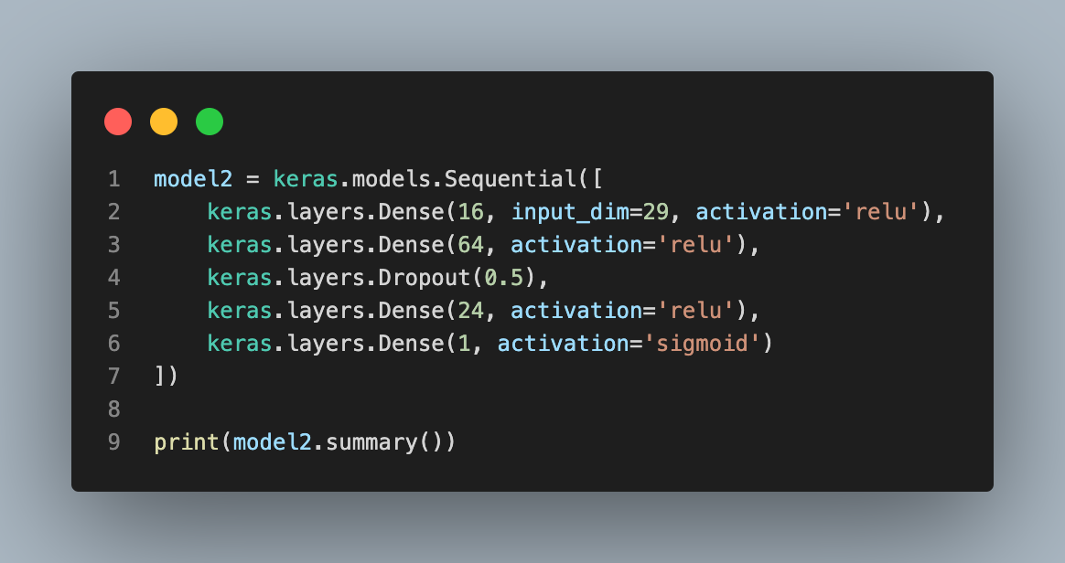
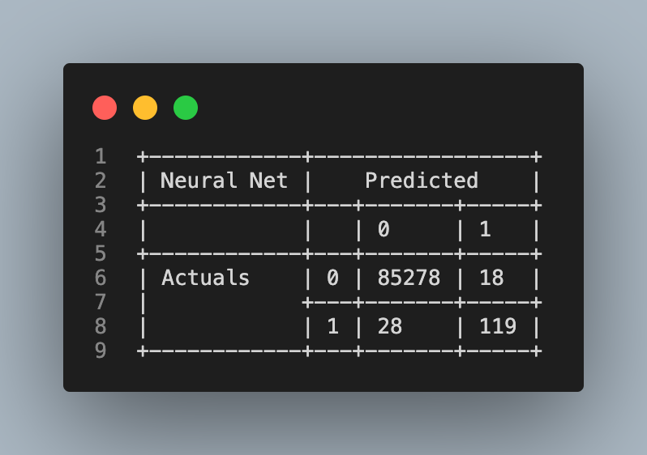
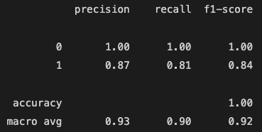
Results – Neural Network

Slide 11
Model Comparison
Logistic Regression
Random Forest
Neural Network

Slide 12
Conclusion & Future Studies
Random Forest and Neural Network are better predictors of credit fraud.
Further studies:
Use SMOTE to balance data
Perform GridSearchCV on Random Forest to identify optimal hyperparameters

